Slide 1


Promise & Async Await

Slide 2
Promise
APA ITU PROMISE ?

Slide 3
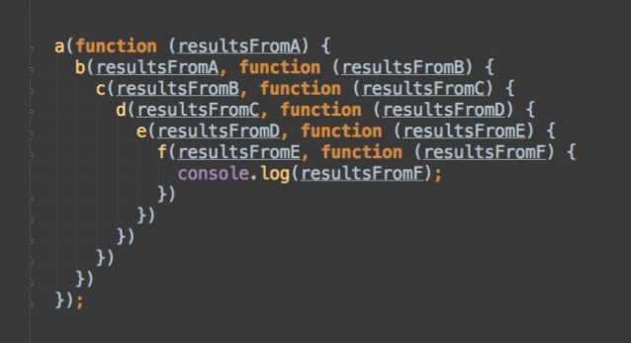
Promise
Callback Hell -> terlalu banyak callback

Slide 4
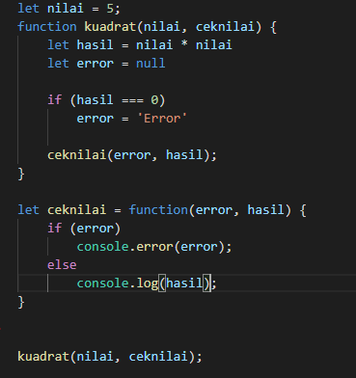
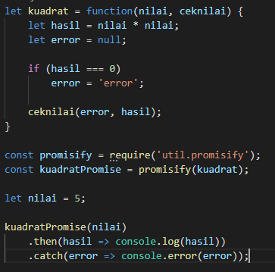
Promise
Callback
Promise

Slide 5
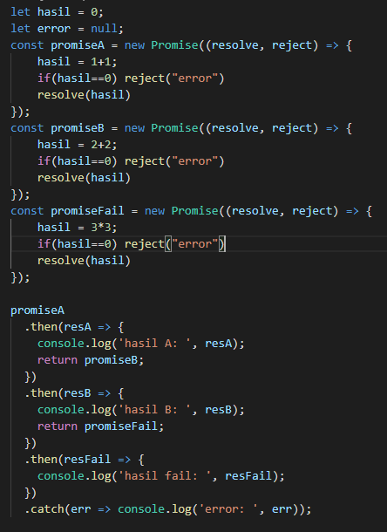
Multiple Promise

Slide 6
Async Await
APA ITU ASYNC AWAIT ?

Slide 7
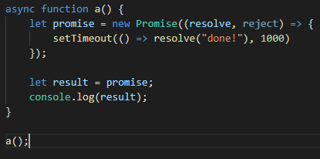
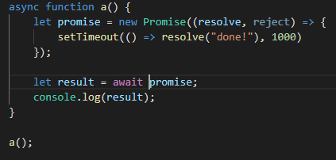
Async Await

Slide 8
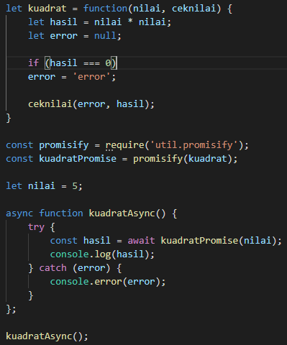
Async Await
Promise
Async Await

